Slide 1

Traffic Accident Crash Factor Analytics : Identifying Key Factors of Traffic Accident Severity and Frequency

Slide 2

INDEX –
1.Introduction
2. Organization Profile
3. Tools and Technologies Used
4. Project Description
5. Result and Findings
6. Challenges and Limitations
7. Conclusion and Future Scope

Slide 3
Acknowledgement
I would like to express my sincere gratitude for this opportunity. This experience has been invaluable in enhancing my skills and providing practical knowledge. I am grateful for the support and guidance
Thank you mam.

Slide 4
What knowledge they gain in internship
An internship provides hands on experience technical skills, Problem solving skills, Teamwork and collaborations, adaptability and flexibility, personal growth preparing future career opportunities.

Slide 5
INTRODUCTIONS –
Objectives of the Internship
The internship provided hands-on experience in data analytics using Python, focusing on data preprocessing, EDA, and visualization. It also improved programming skills with libraries like Pandas, NumPy, and Matplotlib.
Scopes of the project
The scope extended to applying various analytical question framing, understanding the domain deeply, increasing the knowledge in Python Programming, depending on the dataset.
Overview of Data Analytics
Data analytics involves the systematic analysis of raw data to extract meaningful insights. It encompasses data cleaning, transformation, visualization, and interpretation.
About Python Programming
Python is a simple and powerful programming language used for coding, data analysis, web development, and automation. It is easy to learn and widely used in various fields.

Slide 6

Applications of Python
Web Development – Used to create websites .
Data Science & Analytics – Analyzing and visualizing data.
Machine Learning & AI – Building smart systems.
Automation & Scripting – Automating tasks and processes.
Features of Python
Easy to Learn & Use – Simple syntax, like English.
Free & Open-Source – Available for everyone to use.
Interpreted Language – Runs code line by line, no need for compilation.
Object-Oriented & Versatile – Supports different programming styles.

Slide 7



Tools and Technologies Used –
Overview of Python for Data Analytics
Python is one of the most widely used programming languages in data analytics, machine learning, and artificial intelligence due to its simplicity, versatility, and extensive ecosystem of libraries.
Libraries and Frameworks Used
Python offers several libraries tailored for data analytics and visualization.
Pandas: Used for data manipulation and analysis.
NumPy: Essential for numerical computing.
Matplotlib: A foundational library for data visualization.
Data Collection
Techniques Databases: Use SQL to extract structured data.
Web Scraping: Collect data from websites.
CSV/Excel Files: Store and analyze structured datasets.

Slide 8
INTRODUCTION ON TRAFFIC ACCIDENT
Crash Factor Analytics: Identifying Key Factors of Traffic Accident Severity and Frequency
Traffic accidents are a major public safety concern, leading to injuries, fatalities, and economic losses worldwide. Understanding the causes behind these accidents is essential for developing effective prevention strategies.
Crash Factor Analytics focuses on identifying key factors that influence the severity and frequency of traffic accidents. These factors include driver behavior, road conditions, weather, vehicle performance, and traffic regulations.
The goal of this study is to provide insights that can guide policymakers, urban planners, and law enforcement in implementing safety measures.
By identifying the most critical risk factors, Crash Factor Analytics plays a crucial role in making roads safer for everyone.

Slide 9

Problem Statement –
Traffic Safety Challenge: Traffic accidents are a significant public safety issue worldwide, causing loss of life, injuries, and economic costs.
Lack of Understanding: Despite efforts to improve road safety, the key factors influencing traffic accident severity and frequency remain underexplored and inadequately understood.
Key Factors: Various factors such as road conditions, weather, driver behaviour, vehicle characteristics, and demographics may contribute to the frequency and severity of accidents, but their relative importance is not fully quantified.
Objectives of the project –
1. Identify and Analyse Key Factors Contributing to Traffic Accidents
Examine human factors such as distracted driving, speeding, intoxication, and fatigue.
2. Improve Data Collection and Standardization in Crash Analysis
Address inconsistencies in accident data reporting across different sources.
3. Utilize Advanced Analytical Techniques for Crash Prediction
Use predictive modelling to estimate the probability and severity of crashes.

Slide 10
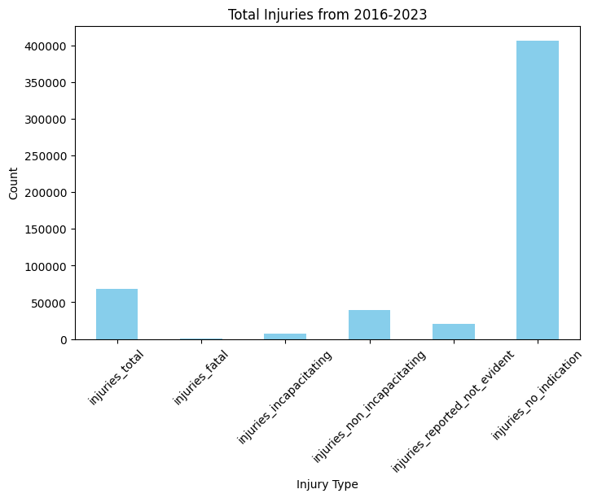
Exploratory Data Analysis (EDA)
Univariate Analysis (Single Variable Focus)
1. What injuries occurred during 2016-2023?
The bar chart shows the total number of different injury types from 2016 to 2023. The "injuries_no_indication" category has the highest count, suggesting most incidents did not result in reported injuries. "Injuries total" is also significant, followed by "injuries_non_incapacitating" and "injuries_reported_not_evident.” This indicates that while accidents are frequent, severe injuries are less common.

Slide 11
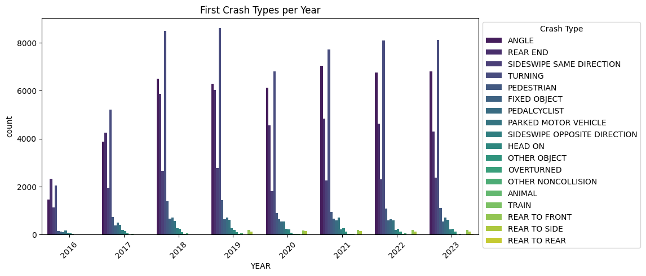
2. How many first crash types were recorded in this year?
The bar chart displays the distribution of different first crash types per year from 2016 to 2023. The most common crash types appear to be "Angle" and "Rear End", consistently having the highest counts each year.

Slide 12
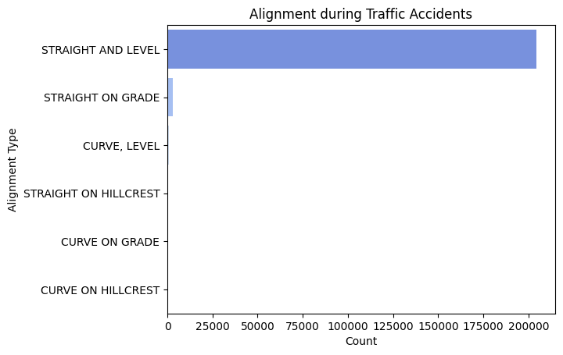
3. Which alignments are present during traffic accidents?
The bar chart shows the distribution of road alignment types during traffic accidents. The vast majority of accidents occurred on "Straight and Level" roads, significantly outnumbering other alignment types.

Slide 13
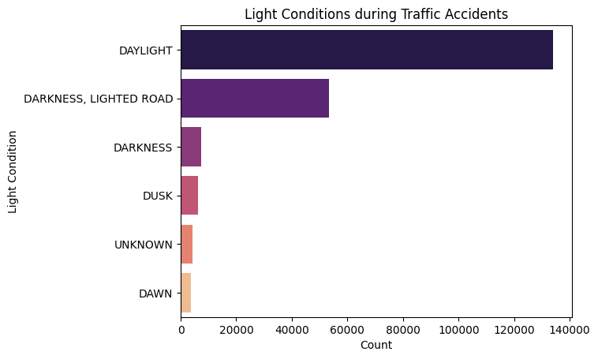
4. What light conditions are present during traffic accidents?
The bar chart illustrates the distribution of light conditions during traffic accidents. The majority of accidents occur in daylight, followed by darkness on lighted roads.

Slide 14
5. In which year do the maximum and minimum traffic accidents occur?
The data shows that 2019 had the highest number of accidents (27,959), indicating a peak in traffic incidents, possibly due to increased vehicle usage, or other external factors.
Maximum accidents occurred in 2019 (27959 accidents) Minimum accidents occurred in 2013 (2 accidents)

Slide 15
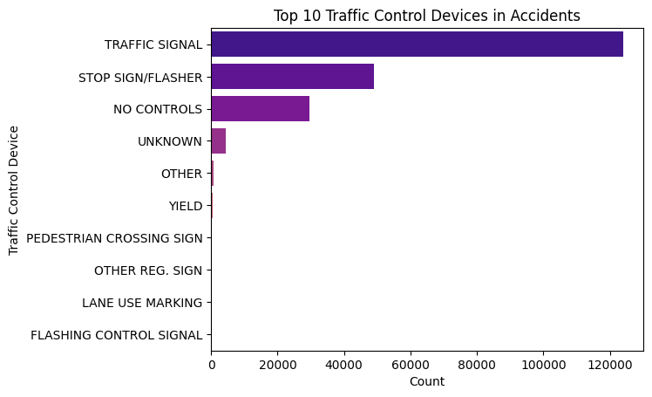
6. What traffic control devices are present during traffic accidents?
The bar chart shows the distribution of accidents based on traffic control devices present at the crash location. The highest number of accidents occurred at traffic signals, followed by stop signs/flashers and areas with no controls.

Slide 16
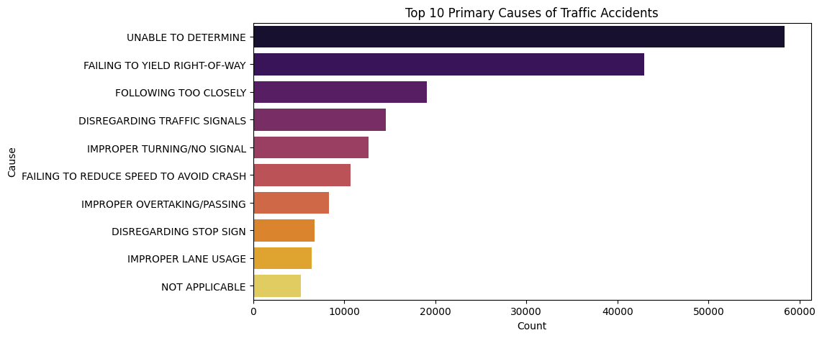
7. What are the primary contributory causes of traffic accidents?
The bar chart displays the top 10 primary causes of traffic accidents. The most frequent cause is "Unable to Determine", suggesting a large number of cases where the exact reason is unclear. Among known causes, "Failing to Yield Right-of-Way", "Following Too Closely", and "Disregarding Traffic Signals" are the leading contributors to accidents

Slide 17
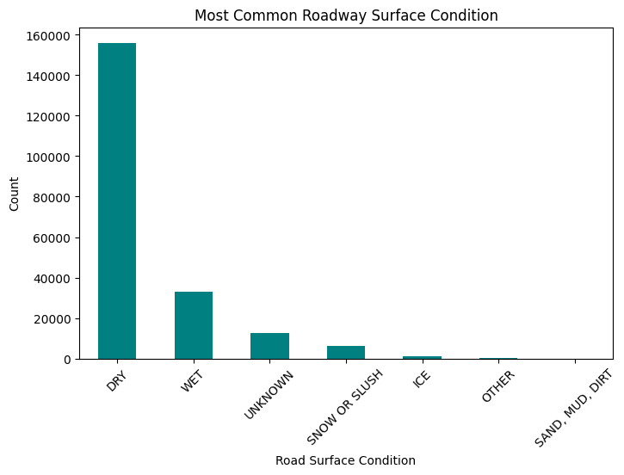
8. What is the most common roadway surface condition during traffic accidents?
The bar chart shows the most common roadway surface conditions during traffic accidents. The majority of accidents occur on dry roads, followed by wet roads, indicating that most crashes happen under normal driving conditions rather than extreme weather.

Slide 18
9. What percentage of accidents resulted in no injuries?
The statistic shows that 73.95% of accidents result in no injuries, meaning that the majority of crashes are minor.
Percentage of accidents with no injuries: 73.95%

Slide 19
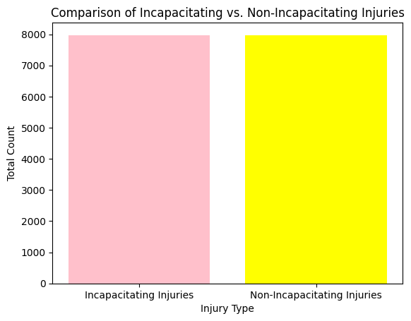
10. How many accidents resulted in incapacitating injuries versus non-incapacitating injuries?
The graph compares incapacitating vs. non-incapacitating injuries in traffic accidents, showing that both types occur at nearly equal rates. This indicates that severe injuries are almost as common as less serious ones, highlighting the significant impact of traffic accidents on public safety.

Slide 20
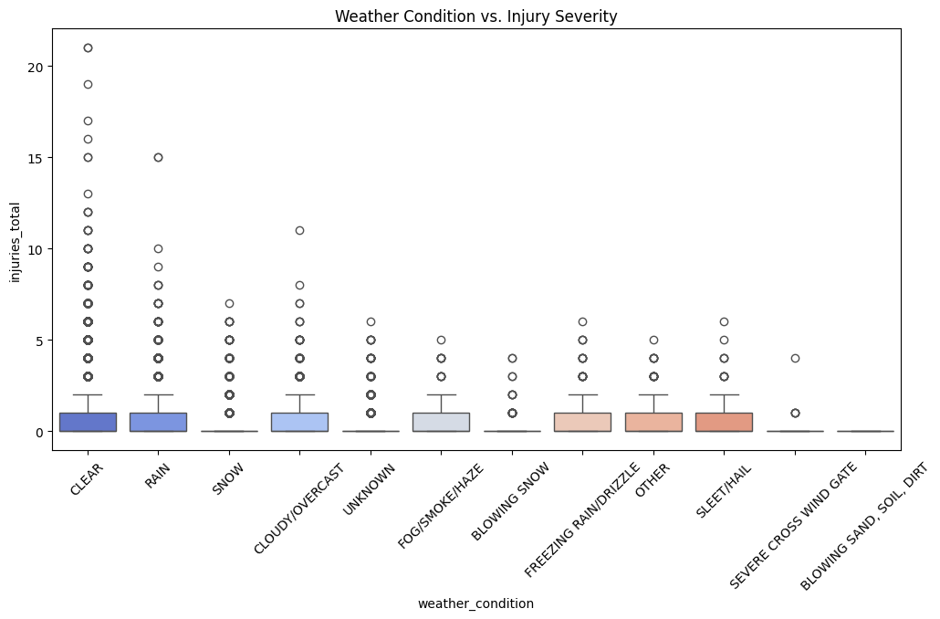
Bivariate Analysis Questions
1. Is there a relationship between weather conditions and the severity of injuries?
The graph illustrates the relationship between weather conditions and injury severity in accidents. It shows that accidents occur across various weather conditions, with clear weather having the most variability in injury severity.

Slide 21
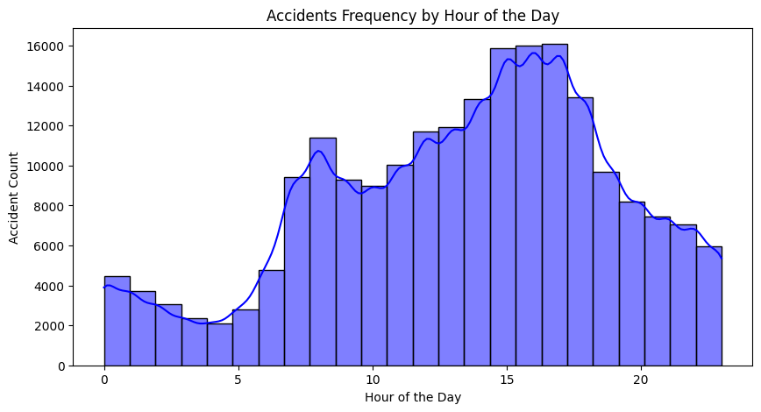
2. Do accidents occur more frequently during certain times of the day?
The graph shows accident frequency by hour of the day. The number of accidents is lowest during early morning hours (midnight to 5 AM), then gradually increases, peaking between 3 PM and 6 PM, likely due to rush hour traffic.

Slide 22
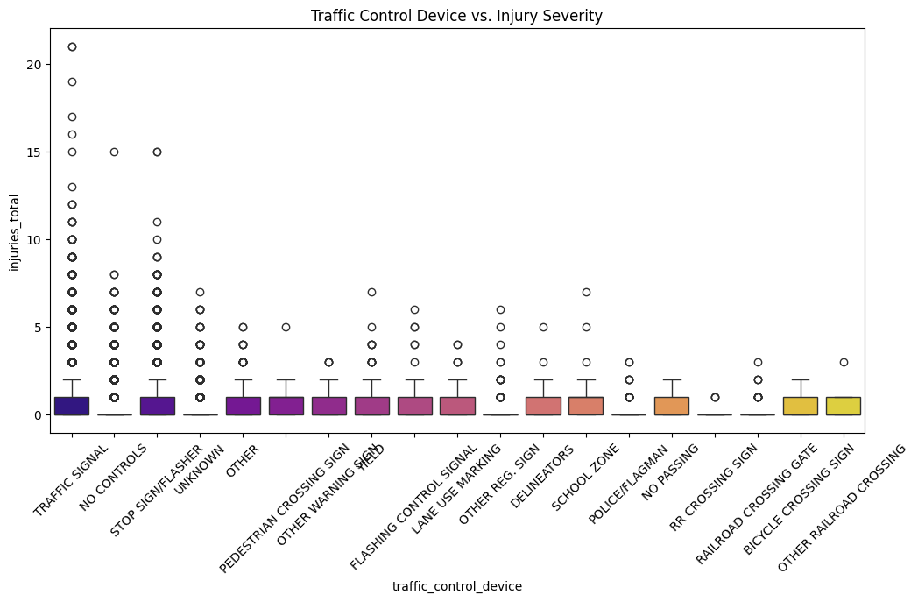
3. How does the type of traffic control device affect crash severity?
The graph illustrates the relationship between traffic control devices and injury severity. It shows that accidents at locations with no controls or traffic signals tend to have a wider range of injuries, including more severe cases.

Slide 23
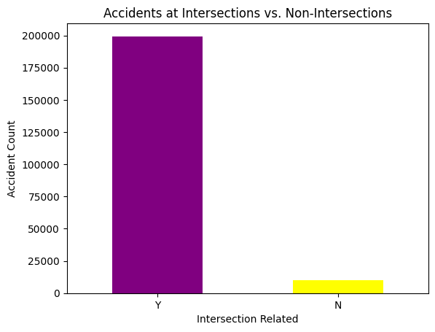
4. Are there more accidents at intersections compared to non-intersection locations?
The graph indicates that the majority of accidents occur at intersections (Y), with a significantly higher count compared to non-intersection areas (N). This suggests that intersections are high-risk zones for accidents, possibly due to factors like traffic congestion, turning movements, and signal compliance issues.

Slide 24
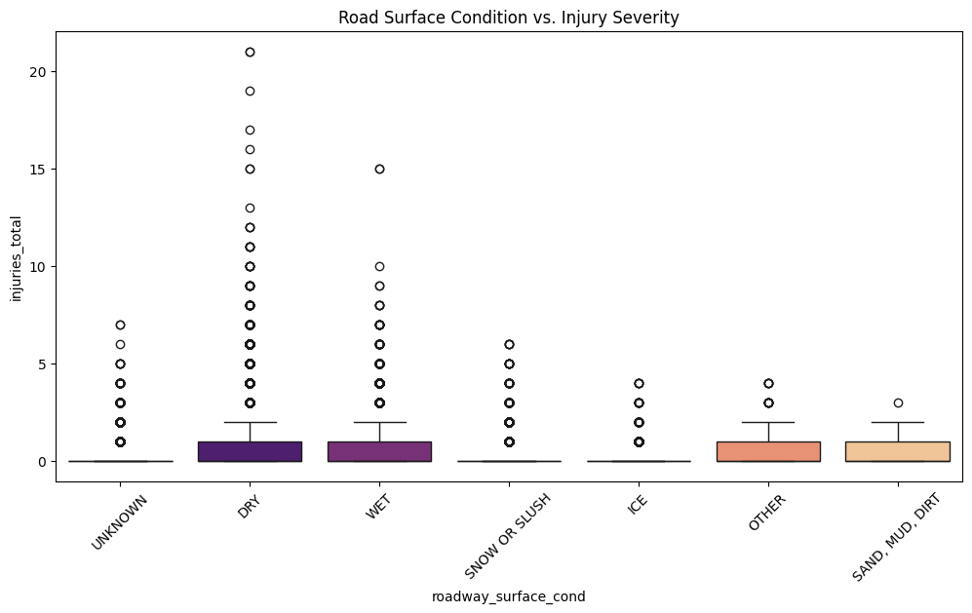
5. Does road surface condition influence the number of injuries in accidents?
The graph shows the distribution of injury severity across different road surface conditions. Dry and wet roads have the highest injury variability, with several outliers indicating severe injuries. Other conditions like ice, snow/slush, and sand/mud/dirt show lower median injuries but still have some extreme cases.

Slide 25
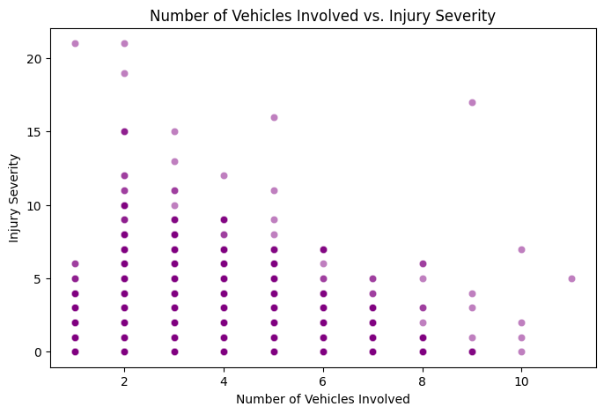
6. Is there a correlation between the number of vehicles involved and the severity of the crash?
The graph illustrates the relationship between the number of vehicles involved in an accident and the severity of injuries. Most accidents involve fewer vehicles (1-4), with a wider spread of injury severity. Severe injuries (higher values) are more frequent in accidents with 1-4 vehicles, while accidents involving more vehicles (6 or more) tend to have lower injury severity.

Slide 26
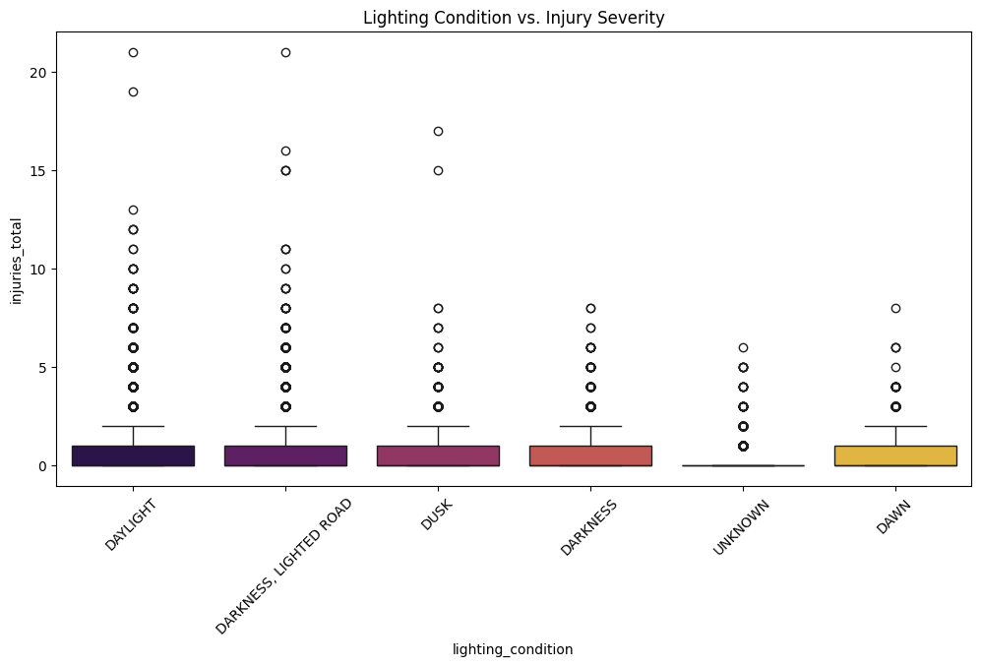
7. How does lighting condition impact accident severity?
The graph shows the relationship between lighting conditions and injury severity in accidents. The injury severity appears fairly consistent across different lighting conditions, with most injuries being low but some outliers reaching high severity.

Slide 27
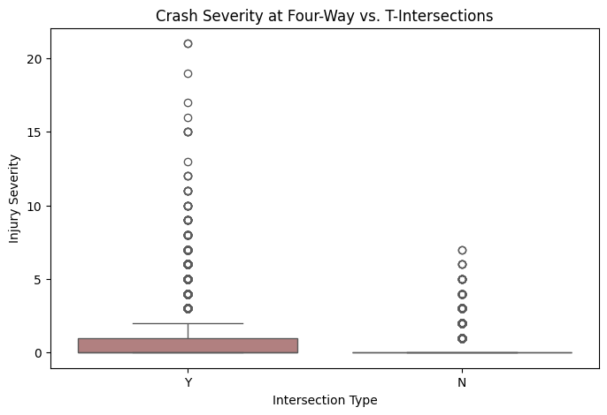
8. Do crashes at four-way intersections differ in severity compared to T-intersections?
The box plot compares injury severity between crashes at four-way intersections (Y) and T-intersections (N). Crashes at four-way intersections tend to have a wider range of injury severity, with more outliers reaching high severity levels. In contrast, T-intersections show lower injury severity overall, with fewer extreme cases.
Notes:
.

Slide 28
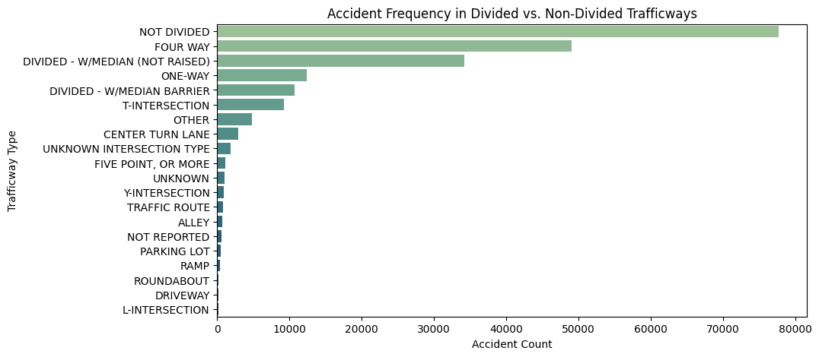
9. Is there a difference in accident frequency between divided and non-divided trafficways?
The bar chart shows accident frequency across different trafficway types. Non-divided roads have the highest number of accidents, followed by four-way intersections and divided roads with medians. This suggests that non-divided roads may pose higher risks for accidents compared to divided roads or controlled intersections.

Slide 29
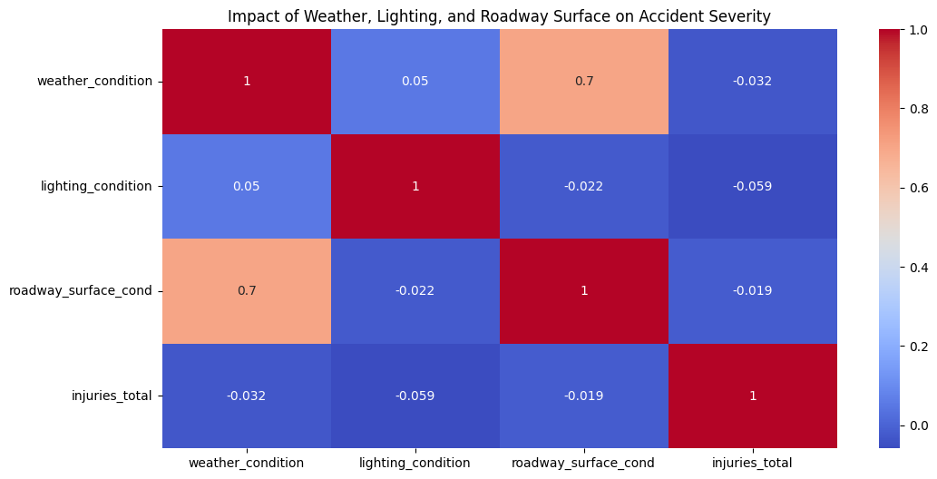
Multivariate Analysis Questions
1. How do weather conditions, lighting, and roadway surface conditions together impact accident severity?
The heatmap shows the correlation between weather, lighting, roadway surface conditions, and accident severity (injuries total).
Weather condition and roadway surface condition have a strong positive correlation (0.7).
Weather, lighting, and roadway conditions have little to no correlation with injury severity suggesting that these factors may not directly impact injury severity in accidents.

Slide 30
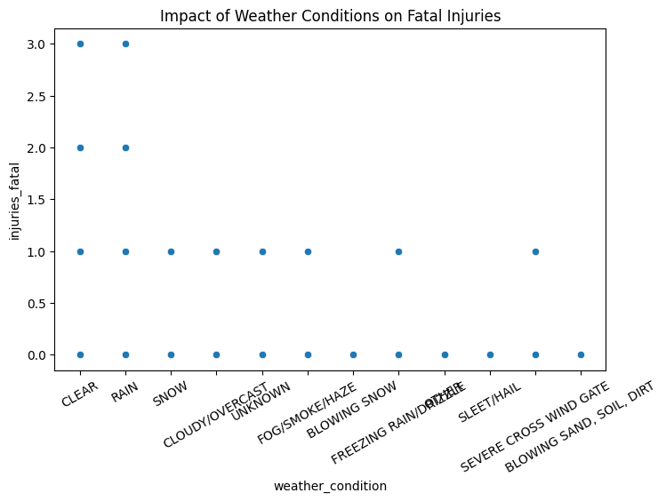
2. What factors (weather, road conditions, time of day) contribute most to fatal crashes?
The scatter plot illustrates the relationship between weather conditions and fatal injuries in crashes. Fatal injuries occur across various weather types, with notable cases under clear, rainy, and snowy conditions.

Slide 31
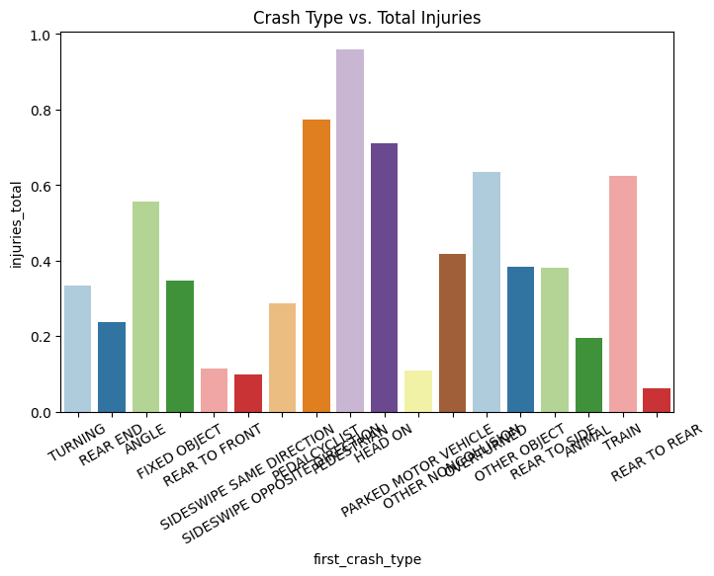
3. How does the combination of crash type, traffic control device, and contributory cause affect the number of injuries?
This bar chart shows the relationship between crash types and total injuries. Different crash types lead to different levels of injury severity.
Pedestrian and bicycle crashes have the highest injury rates. Fixed object and rear-to-rear crashes result in fewer injuries.

Slide 32
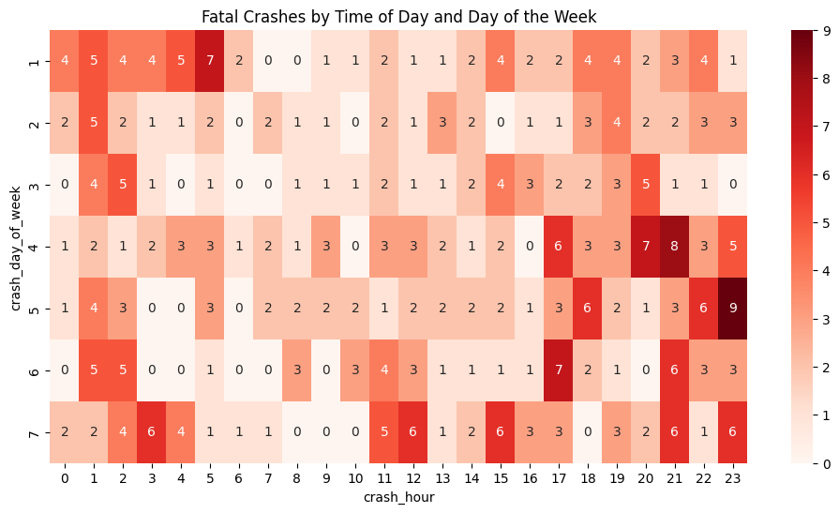
4. Do fatal crashes show a pattern based on the time of day, day of the week, and month?
The heatmap visualizes fatal crashes by time of day and day of the week:
Evening and late-night hours show higher fatal crash frequencies, especially on Fridays and Saturdays.
Early morning hours tend to have fewer fatal crashes across all days.
Peak fatal crashes occur around 2:00-3:00 AM and 18:00-22:00 PM, likely due to fatigue, impaired driving, and high traffic volume.

Slide 33
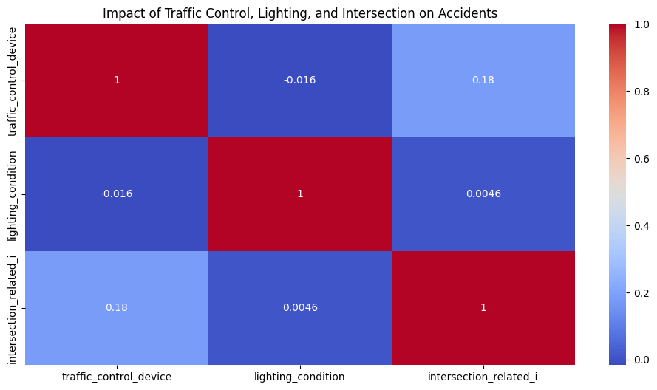
5. What is the combined effect of traffic control devices, lighting conditions, and intersection types on accident occurrences?
This heatmap shows the correlation between traffic control devices, lighting conditions, and intersection-related accidents:
Traffic control devices and intersection-related accidents have a weak positive correlation (0.18), meaning intersections with traffic controls may slightly influence accident occurrences.
Lighting conditions have almost no correlation with either traffic control devices (-0.016) or intersection-related accidents (0.0046), suggesting that lighting has little impact on the presence of traffic control devices or intersection-related crashes.

Slide 34
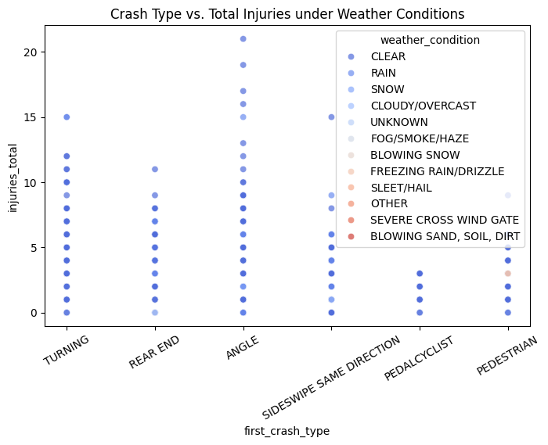
6. How do different crash types vary in injury severity when accounting for weather and lighting conditions?
This scatter plot illustrates the relationship between different crash types and the total number of injuries under various weather conditions. Angle crashes show the highest number of injuries, sometimes exceeding 20, making them one of the most severe crash types

Slide 35
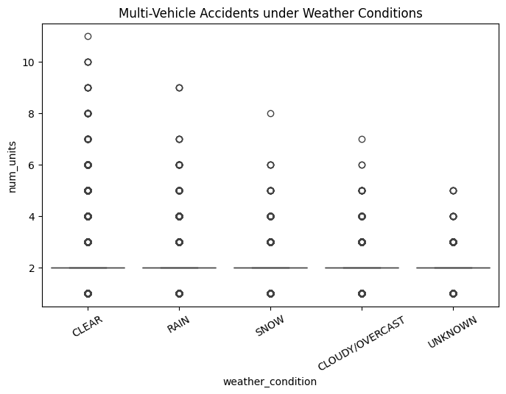
7. Are accidents involving multiple vehicles more likely to happen under specific weather and road conditions?
This boxplot shows the number of vehicles involved in crashes under different weather conditions. Most accidents involve two vehicles, regardless of the weather, as seen by the consistent median line. However, there are cases where crashes involve more vehicles, sometimes up to 10 or more, especially in clear weather.

Slide 36
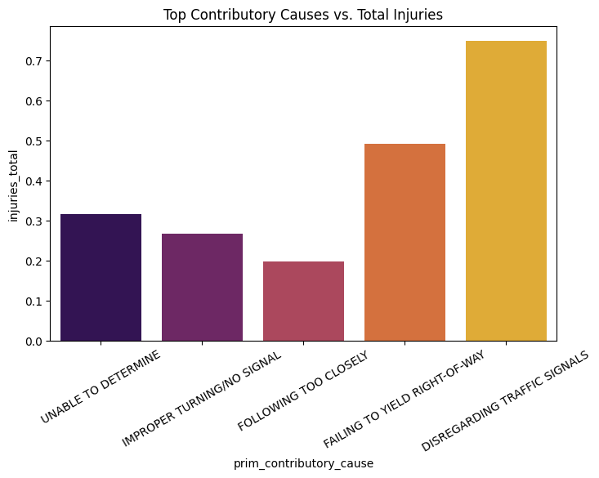
8. What role do primary contributory causes, trafficway type, and intersection-related factors play in determining crash severity?
This bar plot shows the top reasons for accidents and the number of injuries they cause. Disregarding traffic signals leads to the highest number of injuries, followed by failing to yield the right-of-way.

Slide 37
Challenges and Limitations
Challenges -
1) Data Collection and Accuracy
Incomplete or inconsistent data from accident reports, police records, and sensor-based monitoring.
2) Technological and Infrastructure Limitations
Limited deployment of smart traffic management systems in many regions.
3) Human Behaviour and Compliance Issues
Distracted driving, speeding, and DUI(Driving Under the Influence) remain persistent despite strict regulations.
Limitations
1)Data Limitations
Incomplete or missing data from accident reports, police records, and hospitals.
2) Technological Constraints
Limited access to real-time traffic and crash data, especially in developing regions.

Slide 38
Conclusion and Future Scope
Conclusion on Crash Factor Analytics
Crash factor analytics plays a crucial role in understanding the causes and severity of traffic accidents, enabling authorities to develop data-driven strategies for improving road safety. The analysis of key factors such as driver behaviour, road conditions, vehicle safety features, and environmental influences provides valuable insights into accident trends and severity levels.
Future Scope on Crash Factor Analysis
Real-time accident prediction using AI-driven algorithms to detect high-risk scenarios before crashes occur.
2. Smart Traffic Management Systems
AI-powered traffic monitoring to adjust signals dynamically and reduce congestion-related accidents.
3. Connected and Autonomous Vehicles (CAVs)
Self-driving cars with crash avoidance systems that use real-time crash factor analytics.
Vehicle-to-Vehicle (V2V) and Vehicle-to-Infrastructure (V2I) communication to prevent collisions.

Slide 39
THANK YOU

